Slide 1

User-Signup-Desktop
Logo
User
User profile icon
Username
Password
Password confirmation
Signup button

Slide 2

User-Signup-Mobile
Logo
User
User Profile icon
Username
Password
Password confirmation
Signup button

Slide 3

User-login-desktop
Logo
Admin
User
User profile icon
Username
Password
Login button
To create new account

Slide 4

User-Login-Mobile
Logo
User
Admin
User profile icon
Username
Password
Login button
To create new account

Slide 5
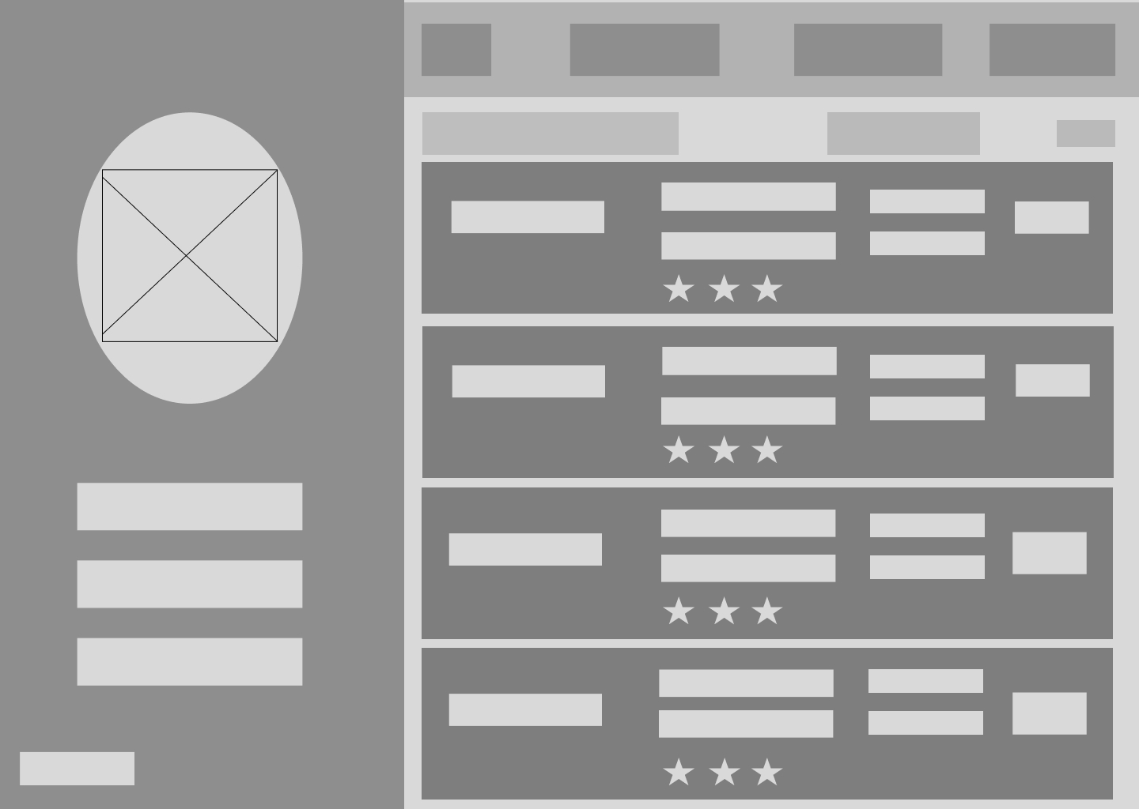
User-home-desktop
Logo
View doctors
View rating
About us
To view list of doctors
Search box
Search button
Appointment date
User profile
icon
Appointment time
Speciality
Book
Doctor’s Name
Location
User Id
Rating
Username
Appointments
Sign out

Slide 6
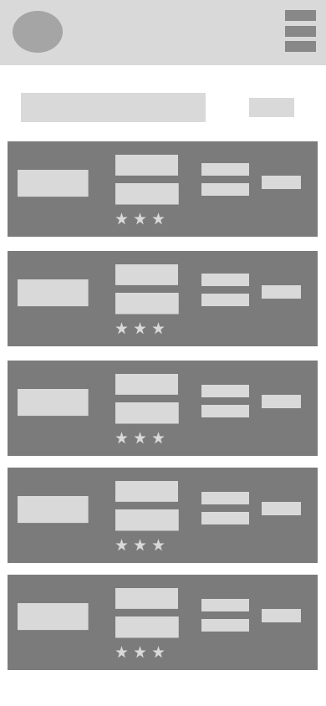
User-home-mobile
Logo
Navigation Element
Search Box
Search Button
Speciality
Appointment Date
Doctor name
Appointment Time
Location
Book
Rating

Slide 7
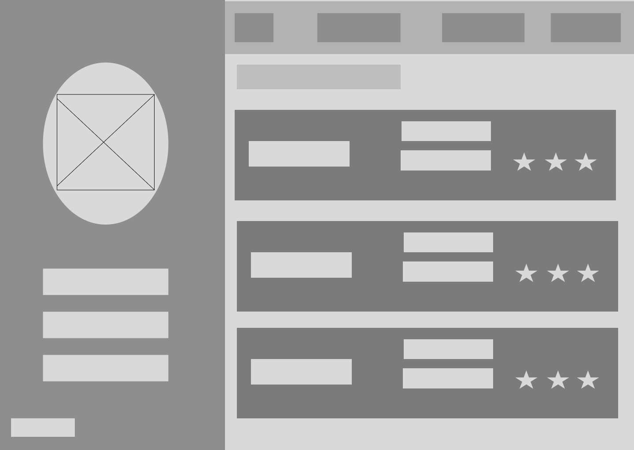
User-rating-desktop
Logo
View doctors
View doctors
About us
To view list of doctors
User profile icon
Speciality
Rating
Location
Doctor’s Name
User id
User name
Appointments
Sign out

Slide 8
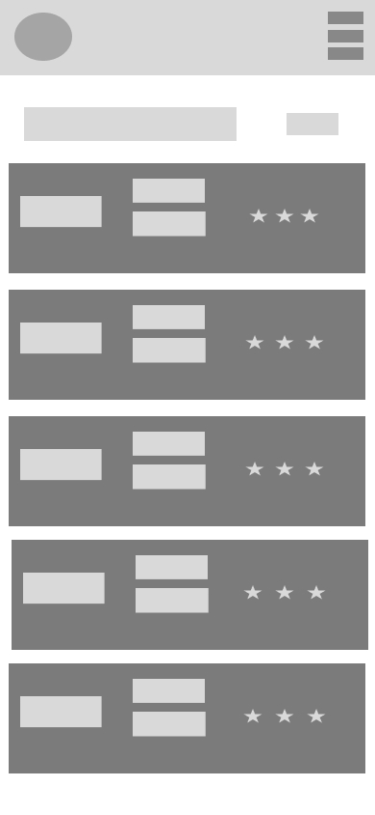
User-rating-mobile
Logo
Navigation Elements
Search box
Search Button
Speciality
Doctor Name
Rating
Location

Slide 9
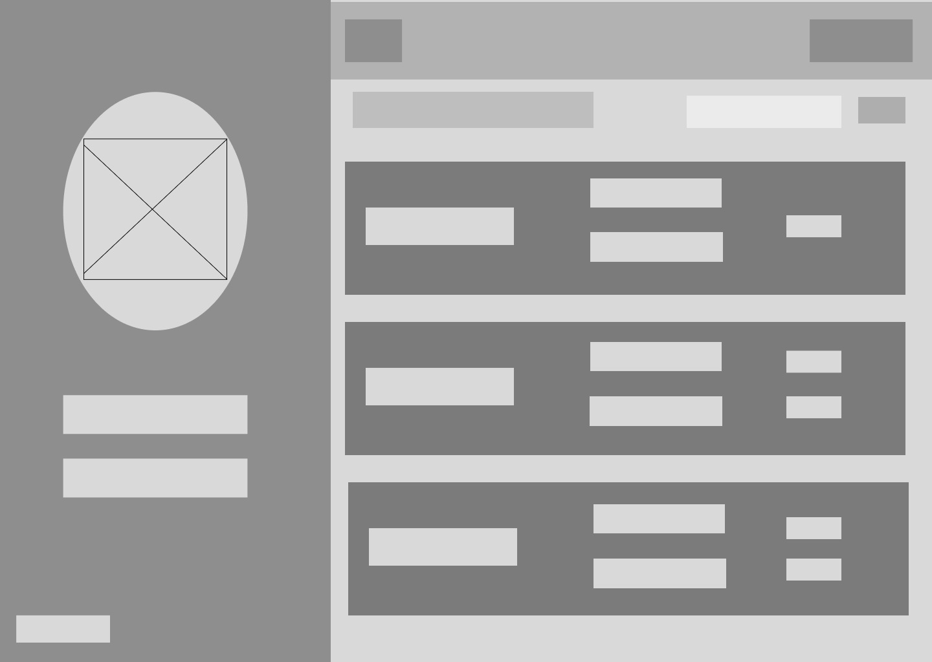
Admin-home-desktop
Logo
Search Box
To view list of doctors
About Us
Search Button
Admin profile
icon
Speciality
Add
Location
Doctor Name
Edit
Admin id
Delete
Admin name
Sign out

Slide 10
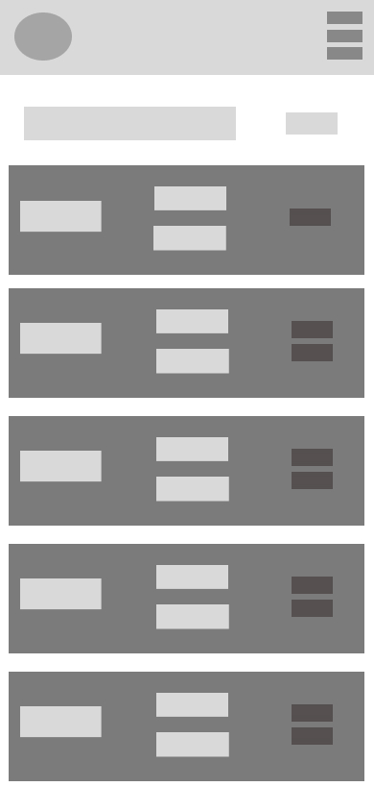
Admin-home-mobile
Admin profile
Navigation Elements
Search Box
Search Button
Speciality
Doctor’s Name
Add
Location
Edit
Delete

